Slide 1

E-COMMERCE
Data Analysis
Here is where our presentation begins

Slide 2
01
02
03
Our team
Our company
Our analysis goals
TABLE OF CONTENTS
04
05
06
Analysis
Stategy
Q&A

Slide 3


OUR TEAM
Panagiotis
Defto
Andreas
Dellamanis
01

Slide 4
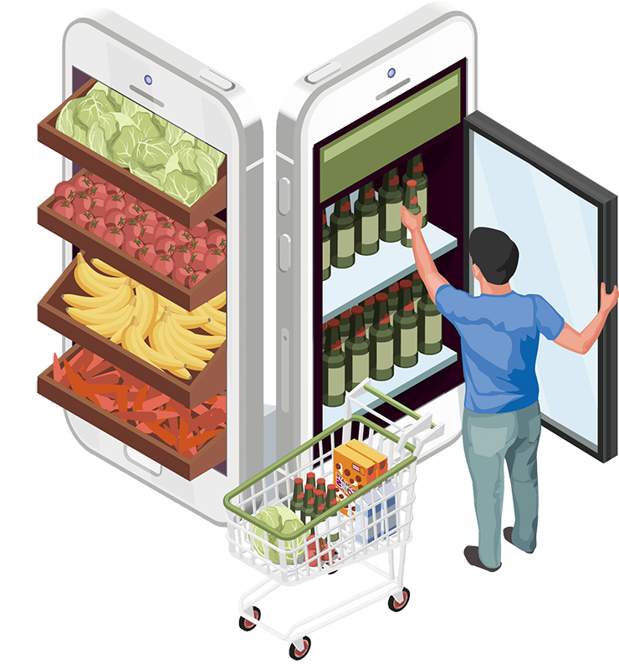
Our company
02
The company of our analysis is a chain of grocery stores that uses an application for online orders since 2014. Our analysis is based on the progress of the online orders from 2014 till 2020

Slide 5
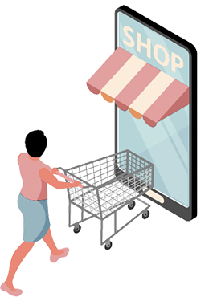
Analysis goals
03
Annual Revenue Growth
Peak Shopping Hours
Origin Country Revenue
Total Revenue From Each Division
RFM

Slide 6

04
Analysis tools
Python
Jupyter Notebooks
Power BI

Slide 7
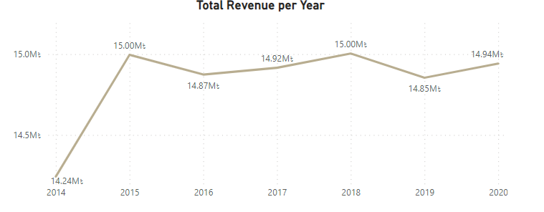
Annual Revenue Growth
103.83M ৳
2014
2015 & 2018
The year 2014 was the first year using the online orders application in our business plan .
Total Revenue from online orders .
The years 2015 and 2018 had the highest revenue .

Slide 8

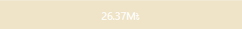


Peak Shopping Hours
Night
Noon
Morning
Afternoon
22:00-7:00
13:00-19:00
7:00-13:00
19:00-22:00

Slide 9
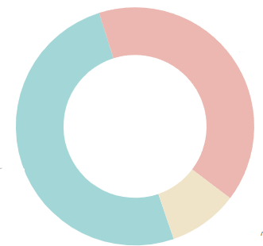

Product’s Origin Continent Revenue
ASIA
EUROPE
NORTH AMERICA
Asian products has total revenue 53M৳.
5 differents Asian countries.
(50.4% of total revenue)
European products has total revenue 40M৳.
4 different European countries.
(40.18% of total revenue)
American product has total revenue 10M৳.
(9.42% of total revenue)

Slide 10
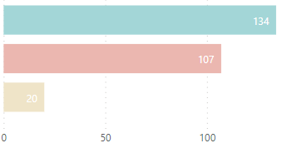
COUNT OF PRODUCTS FROM EACH CONTINENT
Asia
Europe
134 products are coming from Asian countries.
107 products are coming from European countries .
North America
20 product are coming from USA

Slide 11
TOP 5 ITEMS FROM ITS CONTINENT
ASIA
Europe
North America
K Cups Daily Chef Columbian Supremo
K Cups Original Donut Shop Med. Roast
K Cups Folgers Lively Columbian
K Cups - McCafe Premium Roast
Monster Zero Ultra Variety 16 oz
Honey Packets
K Cups A Starbuck's Pike Place
K Cups A Organic Breakfast Blend :
Muscle Milk Protein Shake Van. 11oz
Red Bull Sugar Free 8.4 oz
Red Bull 12oz
K Cups Dunkin Donuts Medium Roas
Topo Chico 12 oz glass
Bounty Paper Towels Select a Size
Lysol Wipes 100 ct

Slide 12
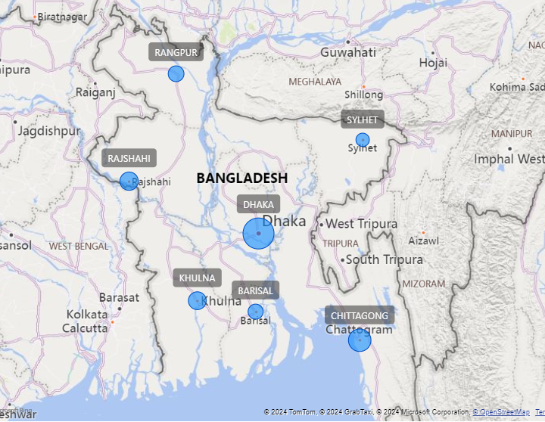
Map
Division
Revenue
Dhaka : 40M৳
Chittagong: 19.5M৳
Rajshahi: 12M৳
Khulna : 11.15M৳
Rangpur: 8.3M৳
Barisal : 7.4M৳
Sylhet : 5.45M৳
Notes:
Καλησπερα και απο εμενα , στην συνεχεια βλεπουμε τον χαρτι του μπαγκλαντεζ και πιο συγκεκριμενα της περιφεριες που εχουμε καταστηματα . Οπως θα περιμεναμε η περιφερια με το υψηλοτερο Revenue ειναι η Dhaka που ειναι η προτευουσα του μπαγκλαντεζ της οποιας ο πλυθυσμος ανερχετε στα 18 εκατομιρια

Slide 13
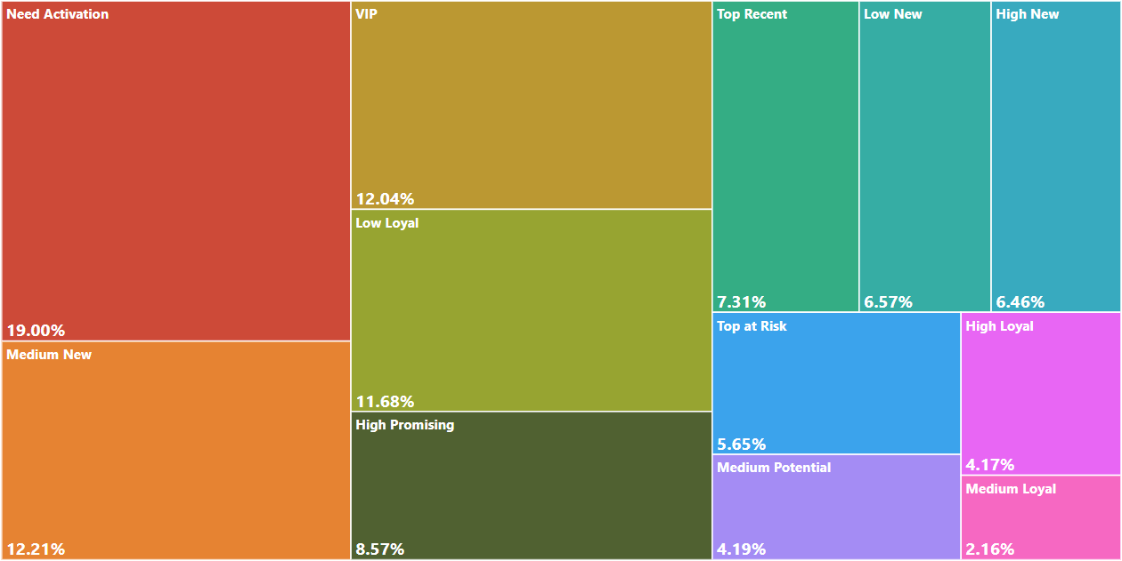
RFM
What is RFM? RFM stands for Recency, Frequency, Monetary, which is a marketing analysis tool used to identify a company's best customers by examining their transaction history.

Slide 14
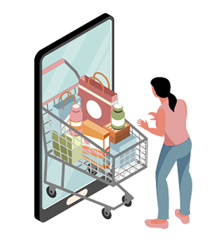
Rfm Conclusion
Medium New - low new
Vip-high Promising
Need Activation-Top at risk
By addressing the specific needs and behaviors of each segment, you can develop tailored strategies to improve customer engagement, retention, and overall revenue.
VIP and High Promising segments are crucial for high revenue. Focus on retaining and nurturing these customers.
Medium New and Low New segments have potential for growth with targeted marketing efforts to increase their frequency and monetary contributions.
Segments like Need Activation and Top at Risk require re-engagement strategies to prevent customer churn

Slide 15
STRATEGY
Customer Awareness: Online App
1
Advertisement
Distribute flyers and posters in your local area.
2
Increase Revenue
Regularly check competitors' prices .
1
Pricing and Promotions
2
05
Need activation and top at risk customers email marketing.
S

Slide 16



THANKS
06
Do you have any questions?
Panagiotis
Defto
Andreas
Dellamanis

